Slide 1
ESTIMATION OF BUSINESS EXPENSES
GOVERNMENT ARTS COLLEGE (AUTONOMOUS)
KARUR-5
FACULTY MENTOR
MISS.K.KALPANA M.Sc.,B.Ed.,
GUEST LECTURE IN MATHEMATICS

Slide 2

TEAM MEMBERS
M.JANANI – TEAM LEADER
P.GAYATHRI – TEAM MEMBER
C.HANSIKA – TEAM MEMBER
D.DHAYANIDHI – TEAM MEMBER

Slide 3
INTRODUCTION
This involves estimating all the expenses required to start and operate the business, such as equipment, rent, inventory and marketing.
By calculating these costs upfront, business owners can better plan their budget and avoid unexpected expenses.

Slide 4
Purpose
The main purpose of their estimation of business expenses is cost estimation. Estimate are documents that provide approximate costs for the project. Small business create them for potential clients. So both parties are clear on the ins outs of a project before it starts.

Slide 5
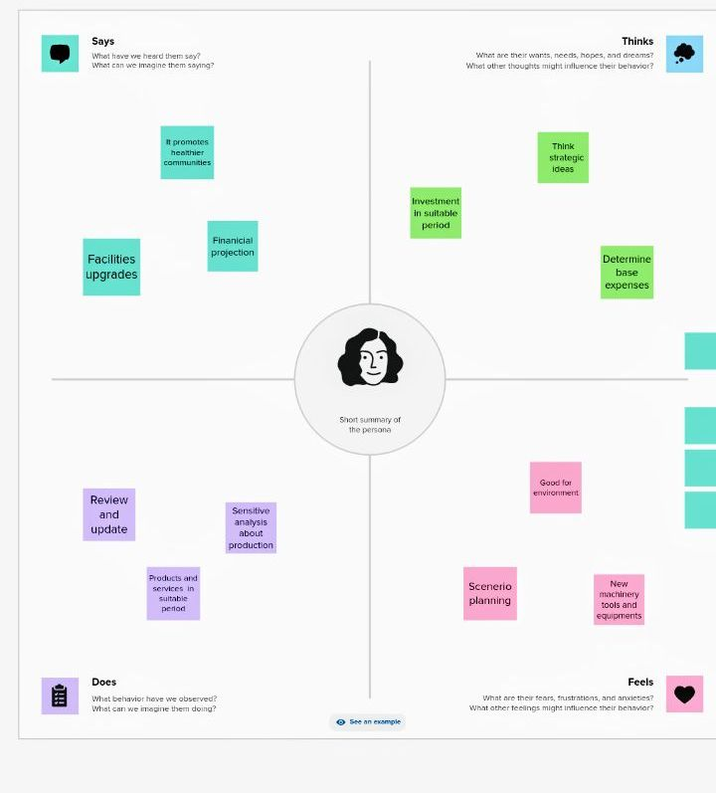
Empathy map

Slide 6
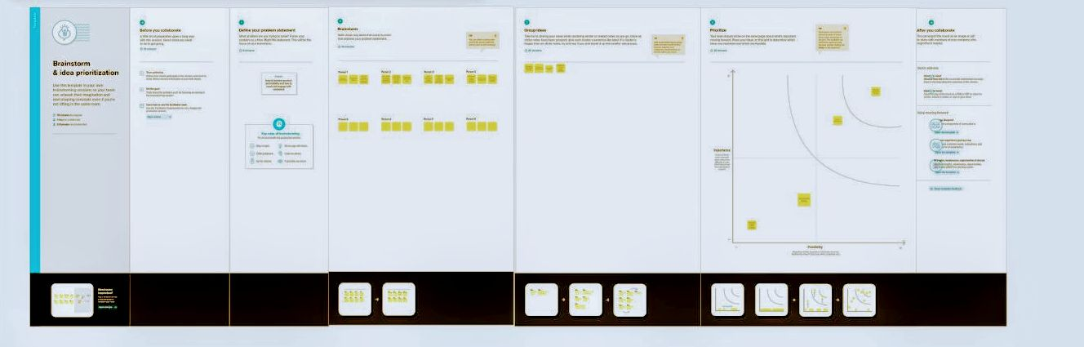
Brain storm

Slide 7
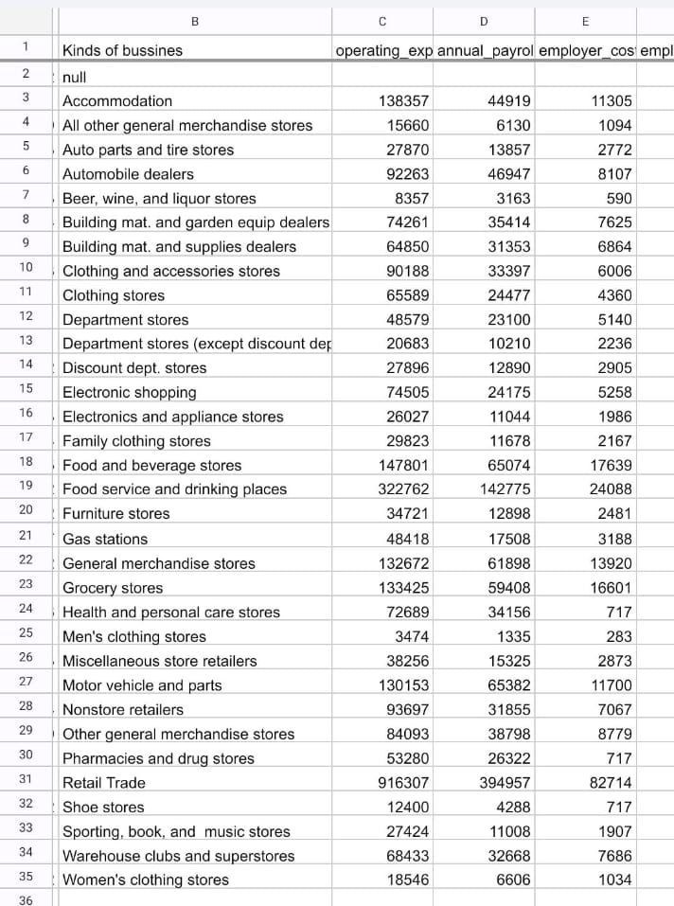
Data set

Slide 8
About data set
Transportation
Taxes & licenses
Employee cost
Fuel
Expenses YoY
Maintenance of buildings
Rental (machinary)
Annual pay roll
Advertisement cost
Equipment cost

Slide 9
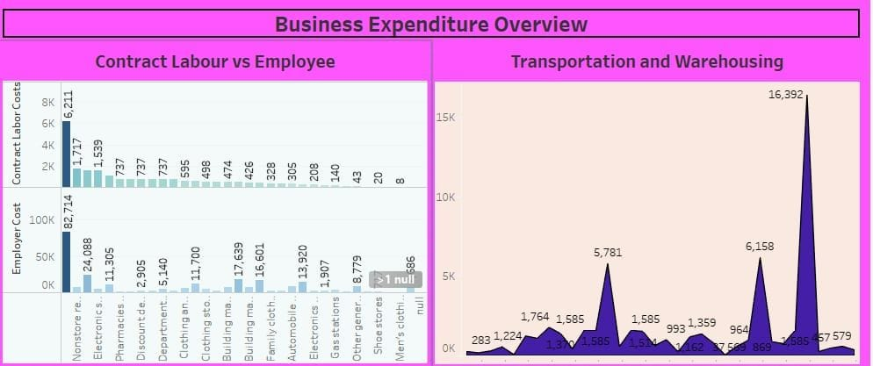
Dashboard

Slide 10
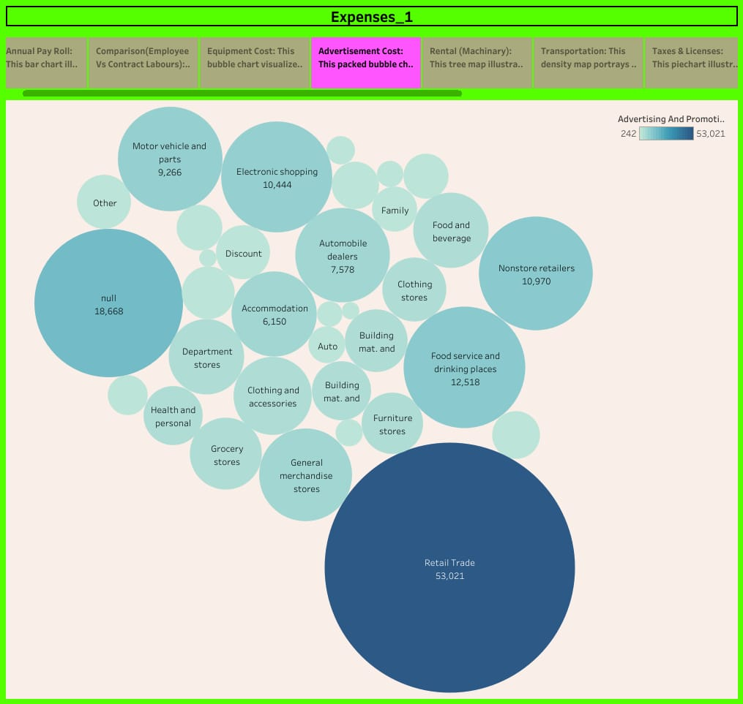
Story

Slide 11
Advantage
The main advantage is cost estimation which helps to determine our project’s budget, schedule the work necessary and manage new resources.
Property owners also we cost estimates to access the feasibility of their project before embarking on actual construction.
It gives increased profit margins.

Slide 12
Disadvantage
It can be expensive to implement and it is time-consuming.
It is not flexible enough to answer what if questions.
New estimates must be built for each alternative.
The product specification must be well-known and stable.

Slide 13
Conclusion
It is an important component of project management that ensures project are finished on schedule and within budget.
For a successful project, proper project cost management is a must.

Slide 14
Future hope
This estimation gives us to achieve our target earlier.
It gives ideas about the strategic business.
Experiences makes us to do our new projects with confident.

